Slide 1

VEHICLE TRACKING SYSTEM
Group Members:
Shamanth M (20171CSE0636)
Someshwar Devanath Tumkur (20171CSE0671)
Srinag Marni (20171CSE0680)
Sujaya V Shetty (20171CSE0686)

Slide 2

What is Vehicle Tracking System
In vehicle tracking system, you can track the location of your vehicle.
This system gives information about vehicle location by sending SMS through GSM modem
This SMS contains longitude and latitude of the location of vehicle.
The system can be installed or hidden in your vehicle.
After installing this circuit, you can easily track your stolen vehicle using a mobile phone. you can also use this application to track the school/college bus.
This device. will continuously monitor a moving Vehicle and report the status of the Vehicle on demand.

Slide 3

Objective
The main objective of this is to build and IOT based vehicle tracking system that works using GPS and GSM technology, which would be the cheapest source of vehicle tracking and it would work as anti-theft system.

Slide 4

How does it work?
VPS uses global positioning system (GPS) and global system using GSM modules
This system contains an Arduino Uno 3 is interfaced serially to a GSM Modem and GPS Receiver
A GSM modem is used to send the position (Latitude and Longitude) of the vehicle from a remote place.
The GPS modem will continuously send the latitude and longitude indicating the position of the vehicle.
The same data is sent to the mobile at the other end from where the position of the vehicle is demanded.
When the request by user is sent to the number at the GSM modem, the system automatically sends a return reply to that mobile indicating the position of the vehicle in terms of latitude and longitude in real time.

Slide 5

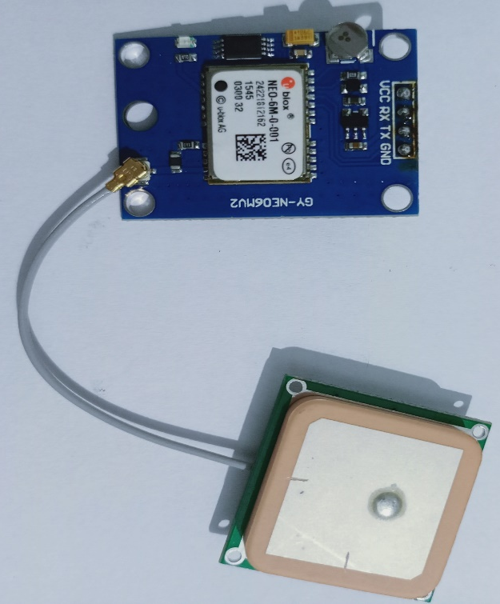
Global positioning system (GPS)
void setup()
{
}
void loop()
{
}
DIAGRAM
CODE
VCC
TX
AX
GND
ANTENNA

Slide 6
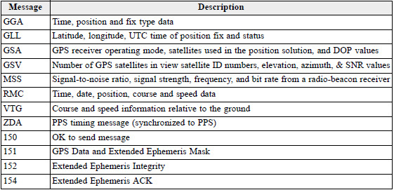

Slide 7
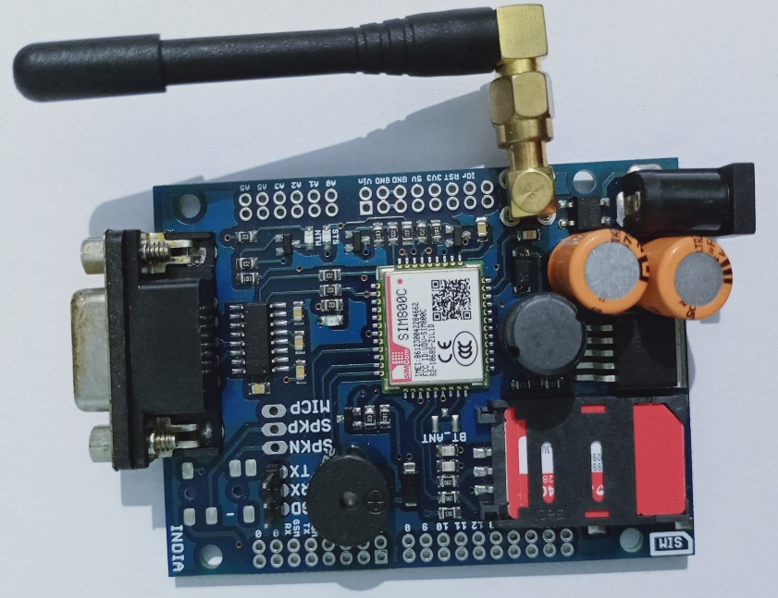
Global System for Mobile Communications (GSM)
DIAGRAM
CODE
#include<SoftwareSerial.h>
SoftwareSerial gsm(2,3);
void setup(){
Serial.begin(9600);
gsm.begin(9600);}
void loop(){
if(gsm.available()) {
Serial.write(gsm.read());
} if(Serial.available()) {
byte a=Serial.read();
if(a=='#') {
gsm.write( 0x1a );
}
else {
gsm.write(a);
} }}
ANTENNA
TX
POWER SUPPLY
SIM800C MODULE
SIM SLOT
RX

Slide 8
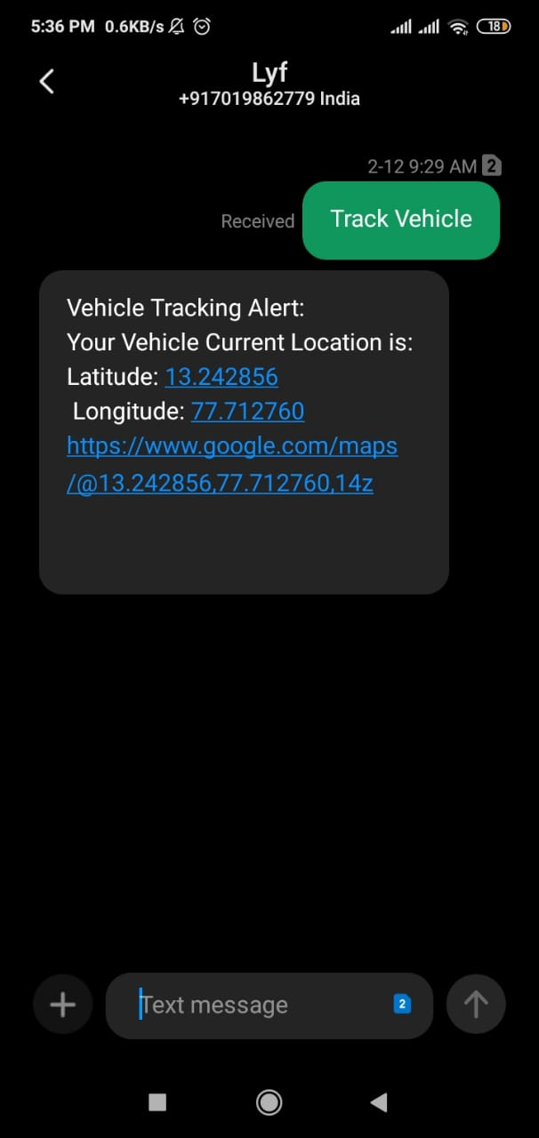
Sending message
AT+CMGF=1: Sets the SMS mode to TEXT AT+CMGS="phone number"<Enter>, sets the recipient's mobile number, and then returns: ">" To send the required content, such as "Send massage test!", there is no need to press enter at the end. After editing the short message, send a “1A” in hexadecimal format for sending the message.(1A is the key value of "CTRL+Z", which is used to tell the module to perform the “send” operation. To cancel the operation, send 1B or "ESC")

Slide 9
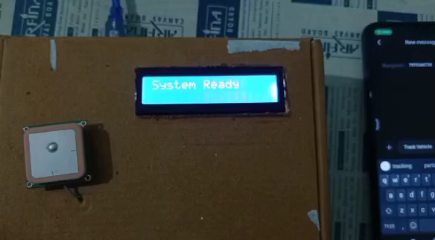
DEMONSTRATION OF THE SYSTEM
https://drive.google.com/file/d/1prGwC91XHxfiFWx4Al75TmzRSxoWFhbM/view

Slide 10

Scope of development
We can send multiple SMS to multiple mobile numbers. Also, we can dial a call to the mobile numbers. Over-speed detection and hard breaking detection can be done in a future enhancement. We can send data to a server using IOT (Internet of Things) and then we can see the location by accessing the website through internet.

Slide 11
Any Questions or Doubts ?

Slide 12


